Slide 1

Minimal Reproducible Examples
Zaw Myo Tun (MBBS PhD)
22 Jul 2023

Slide 2
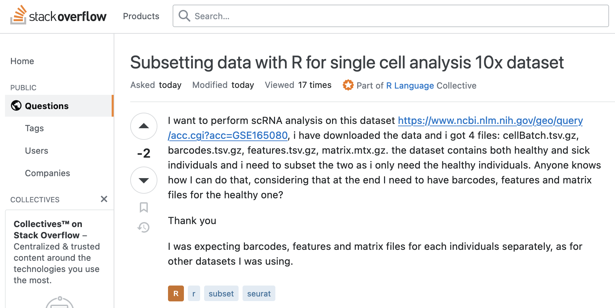

Slide 3
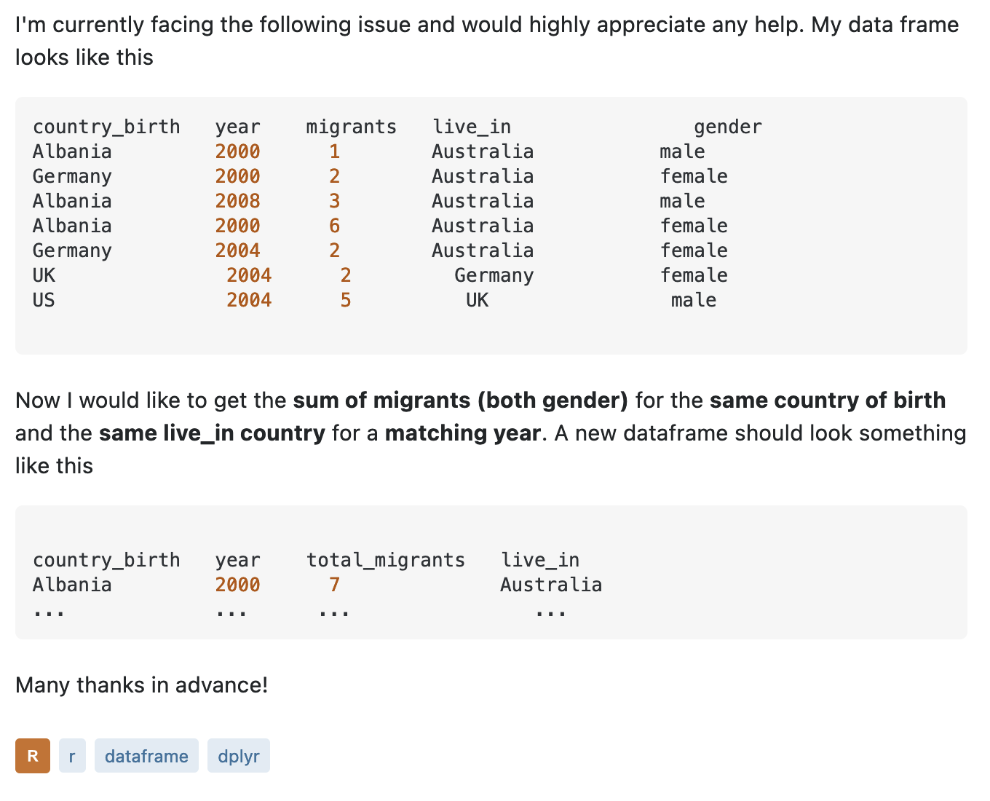

Slide 4
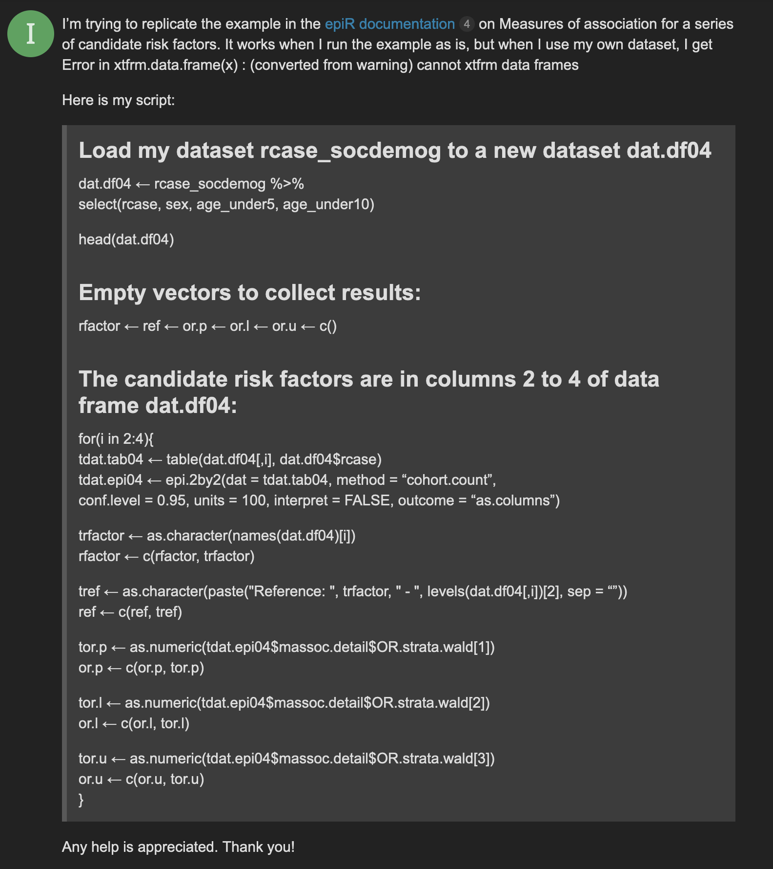

Slide 5

Reproducible Example (reprex)
A minimal example that can be easily understood, ideally by easily running on another person’s machine.

Slide 6
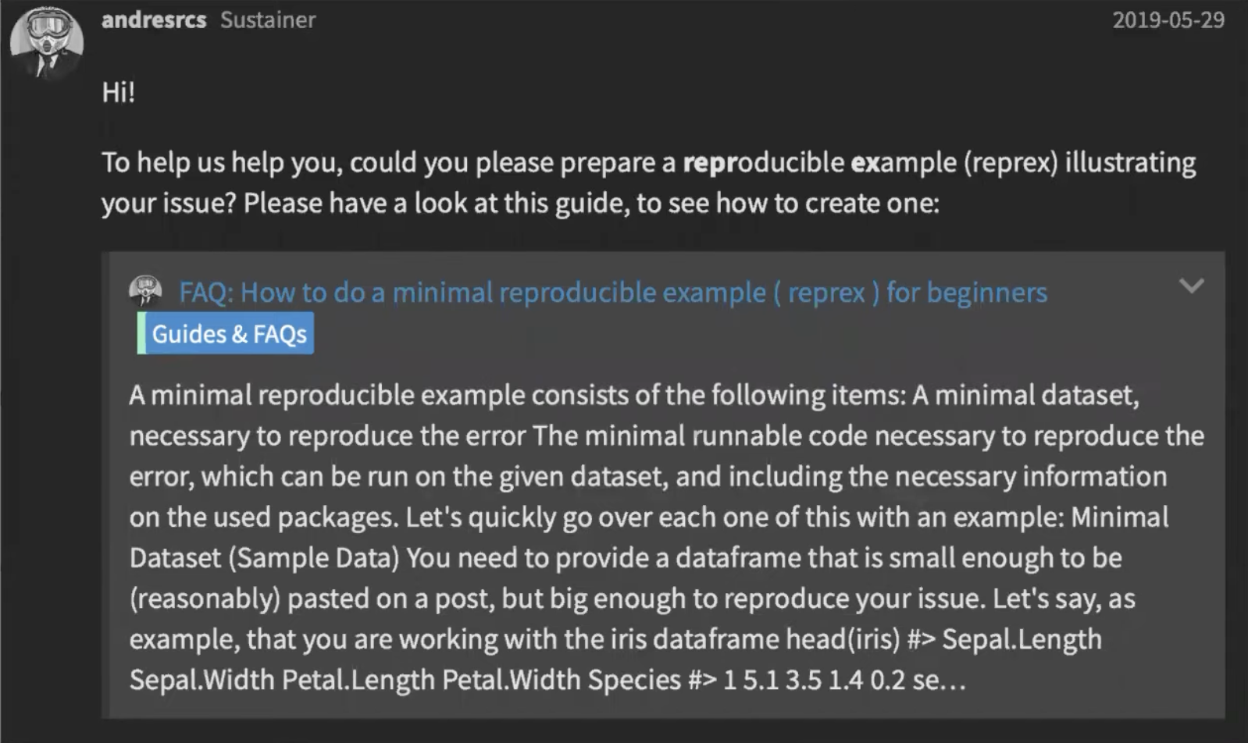

Slide 7
Reprex elements
Example data
Show used libraries
Copy, paste, run by others
Do no harm (avoid rm(list = ls()))

Slide 8
Example data
Built-in
data() command
Build it with constants
dput() real data
Simulate data – set.seed()

Slide 9
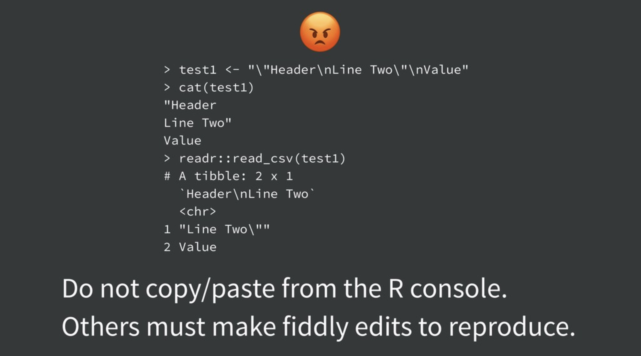
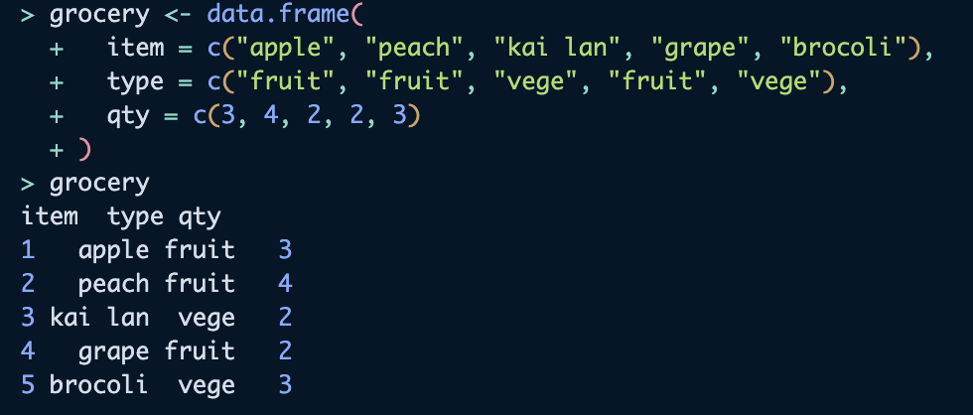

Slide 10
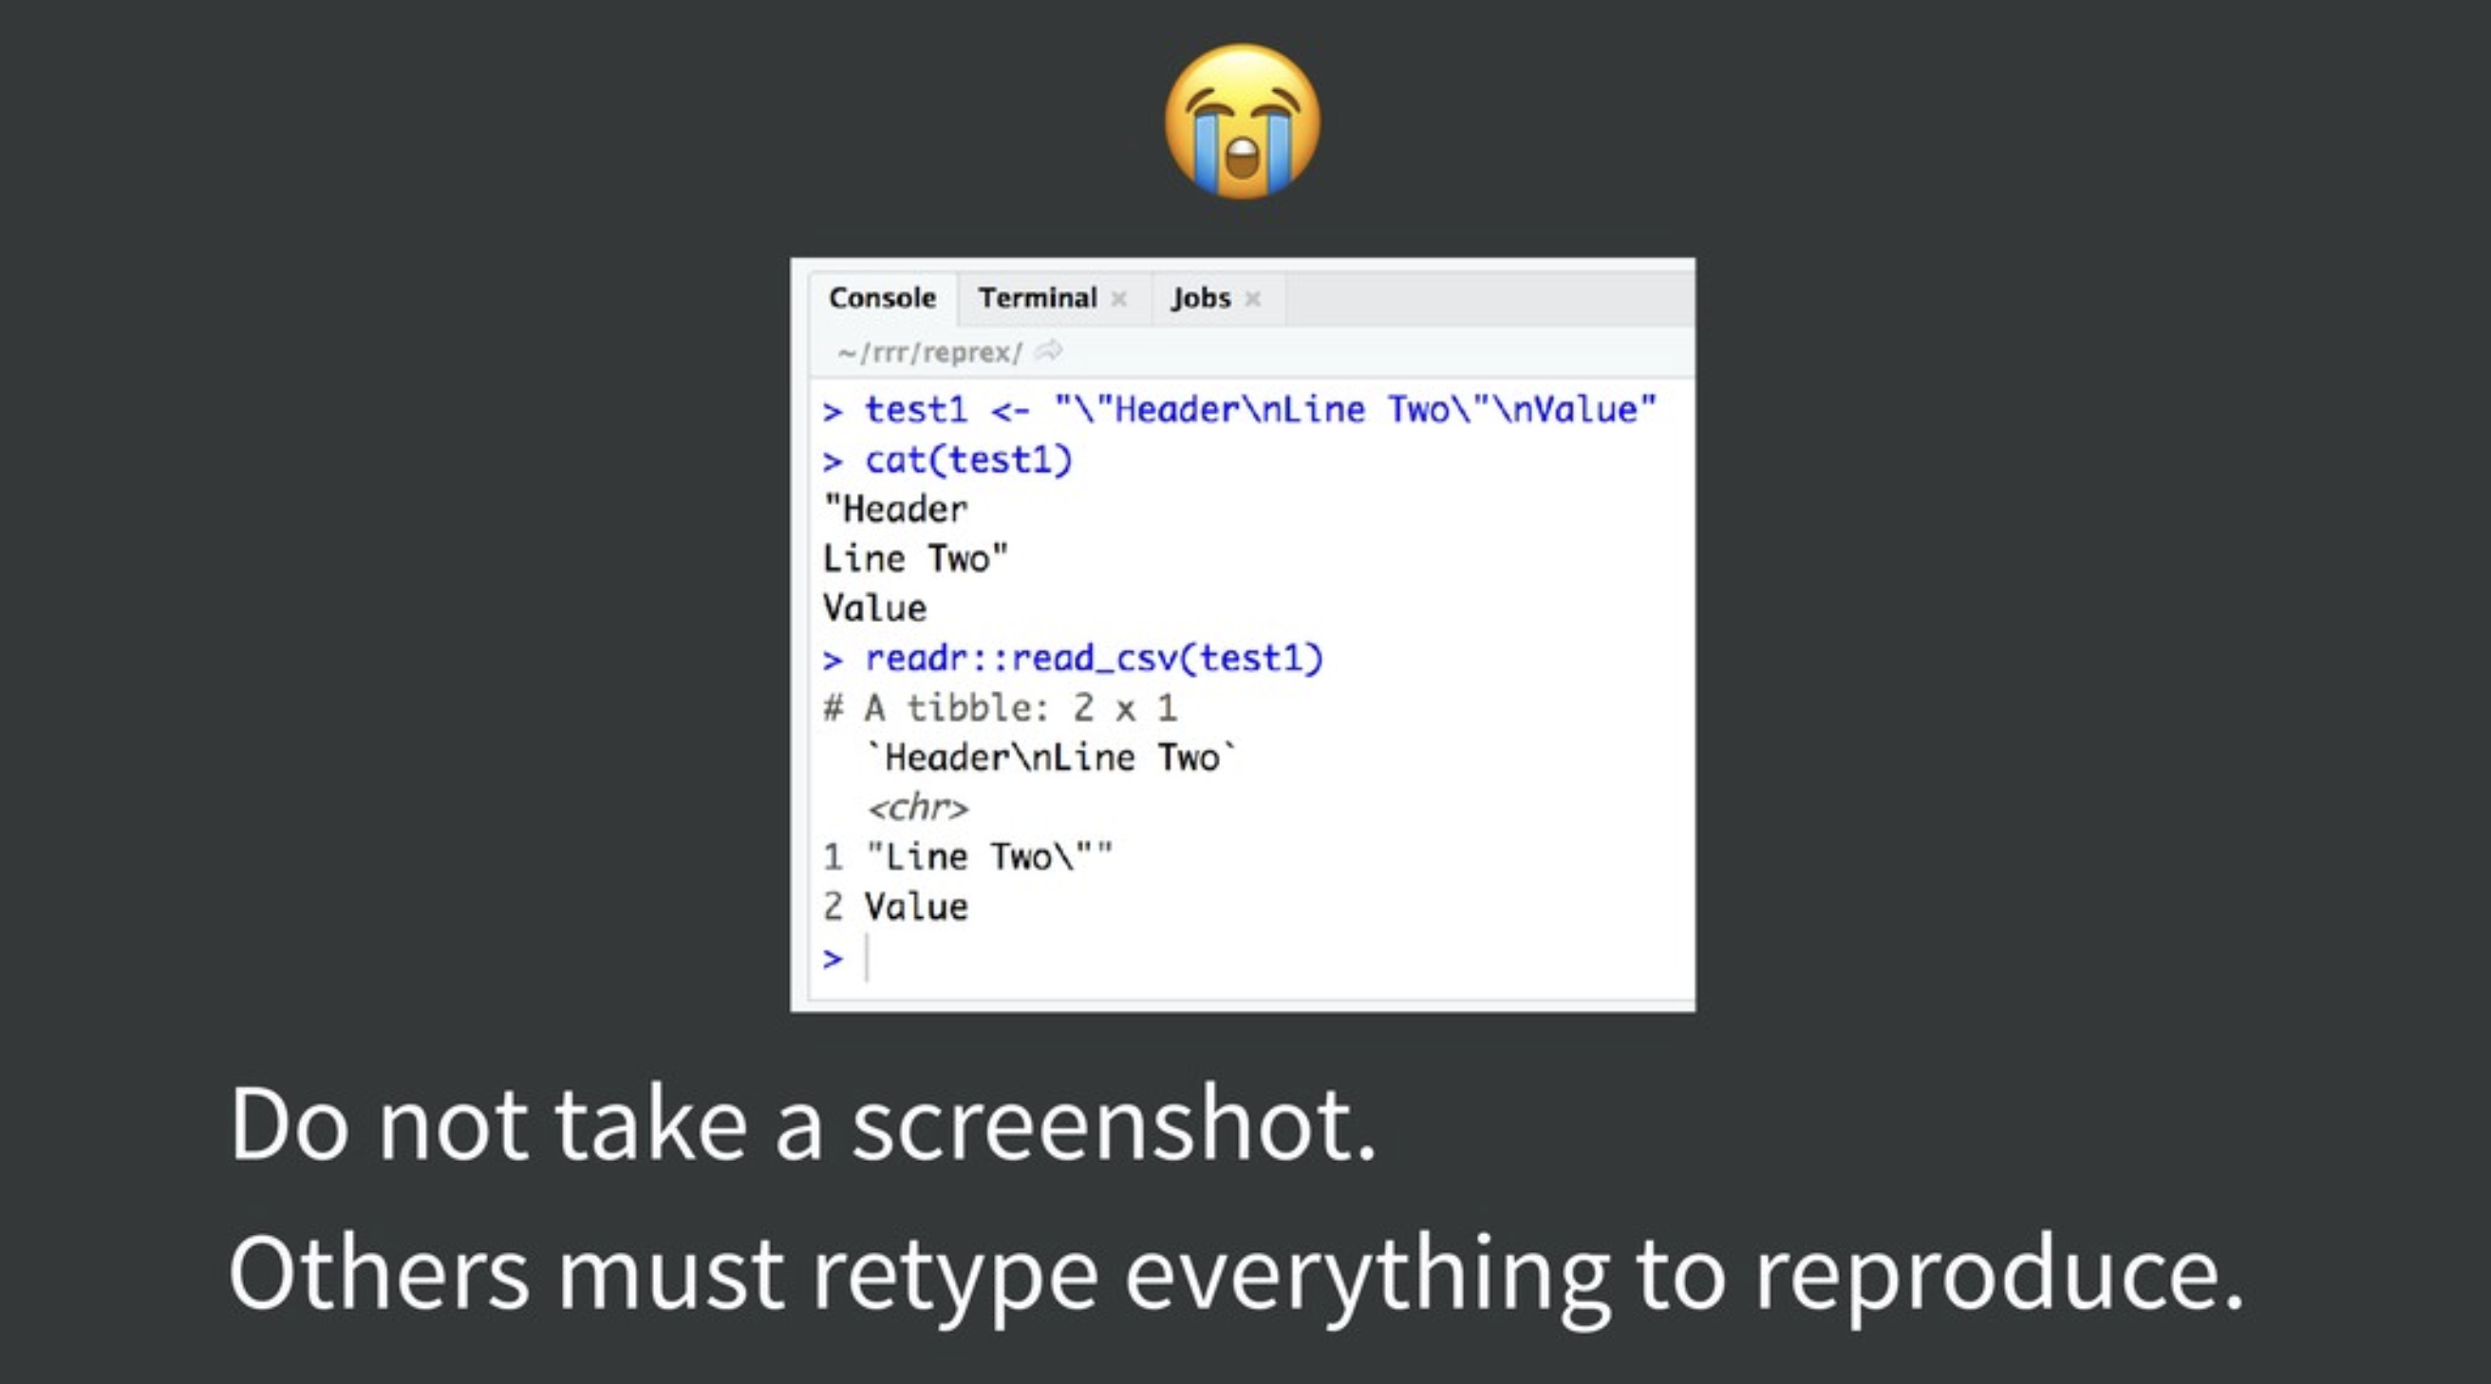
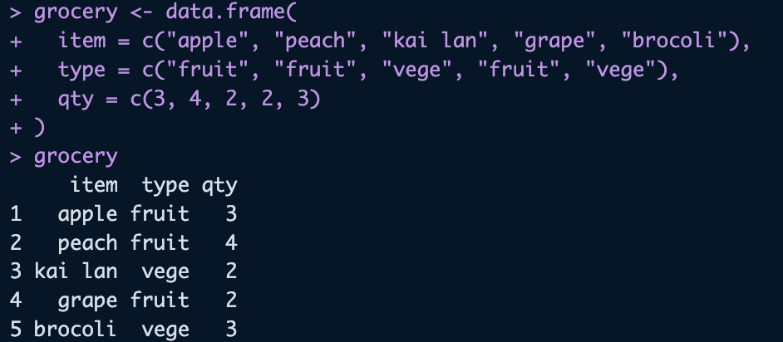

Slide 11
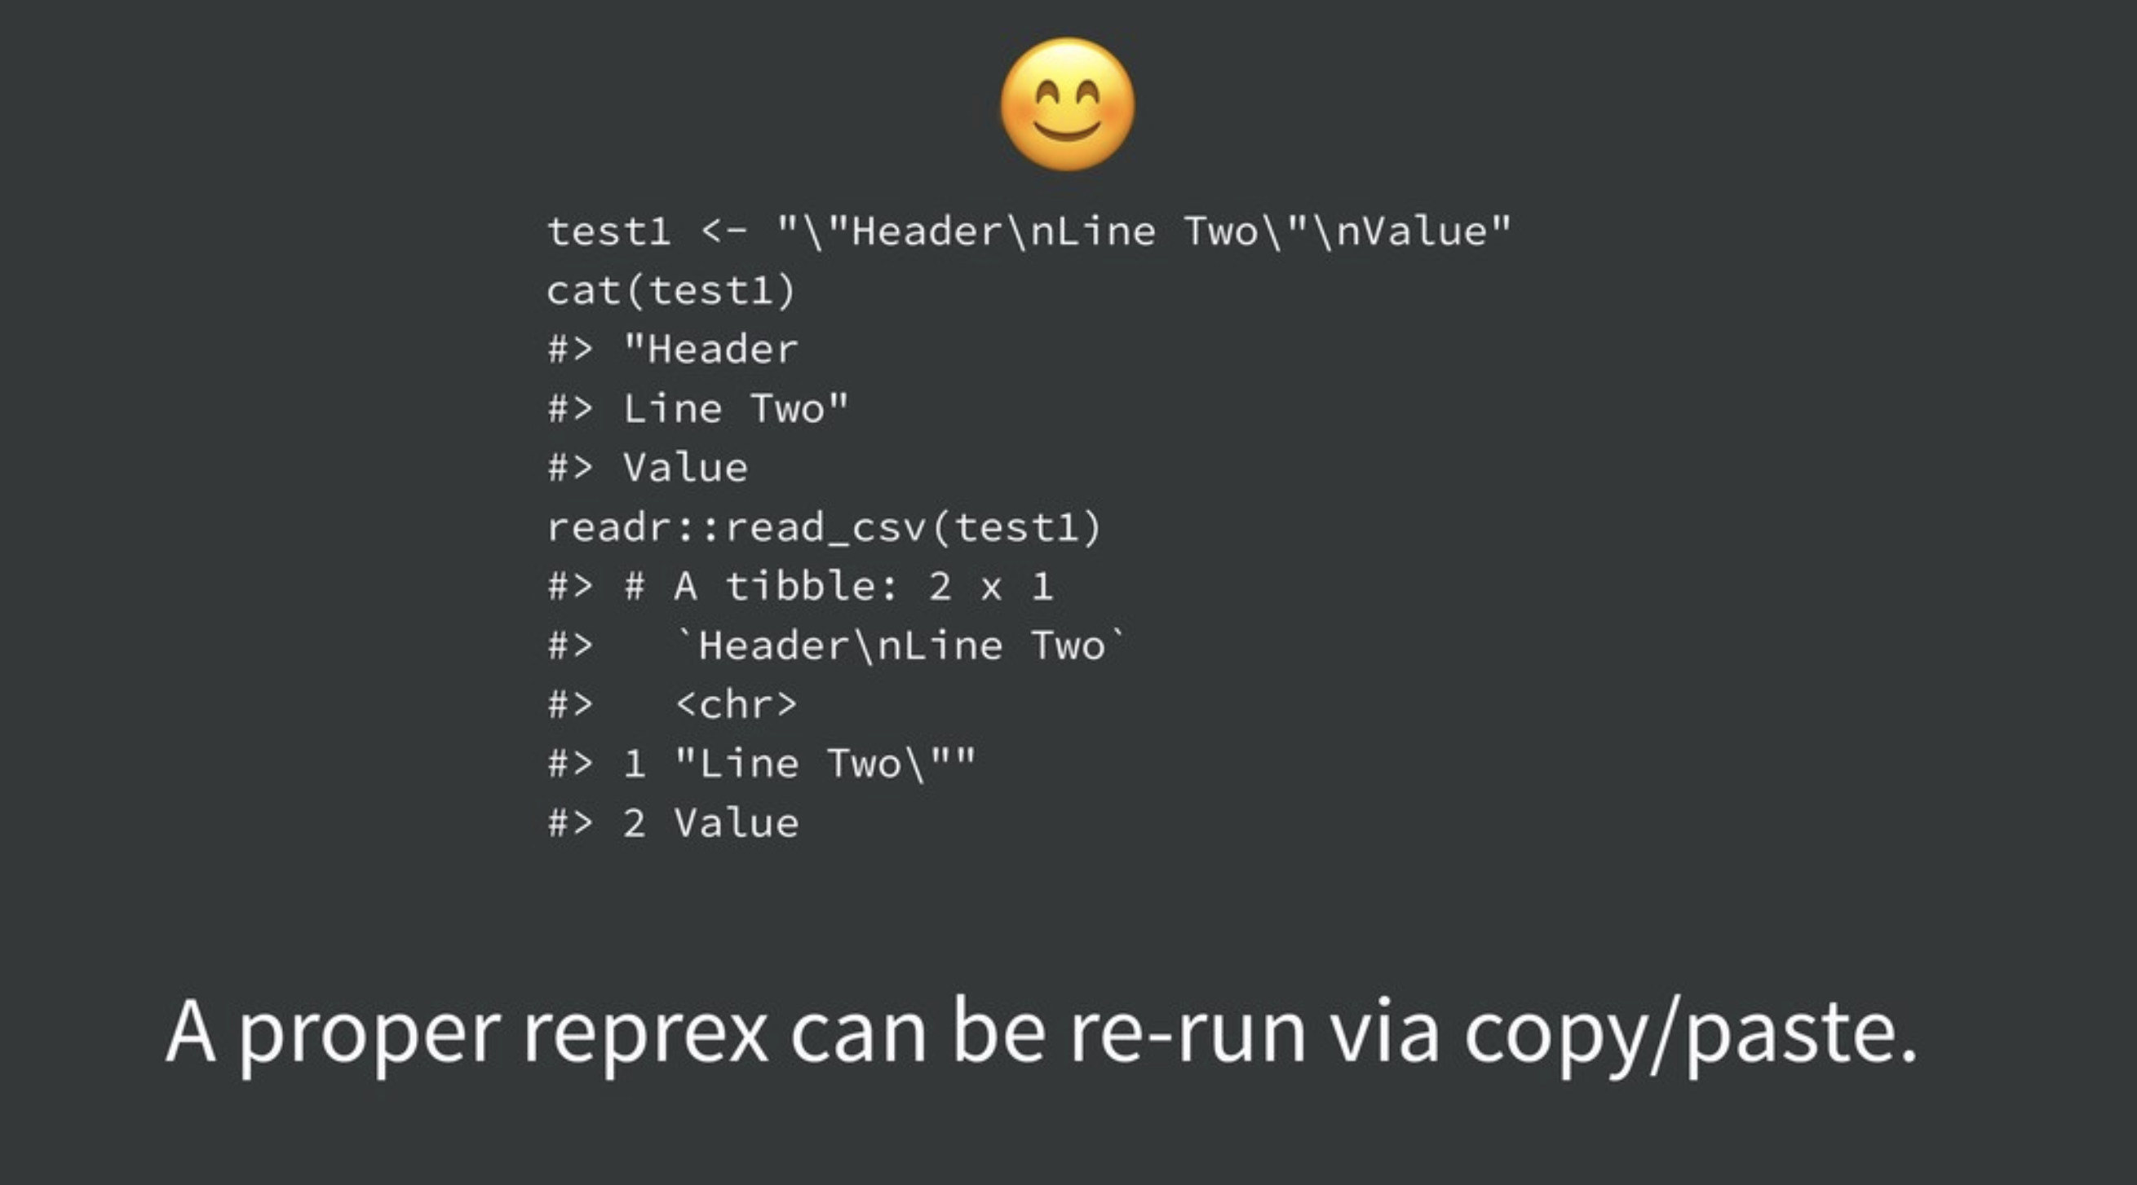
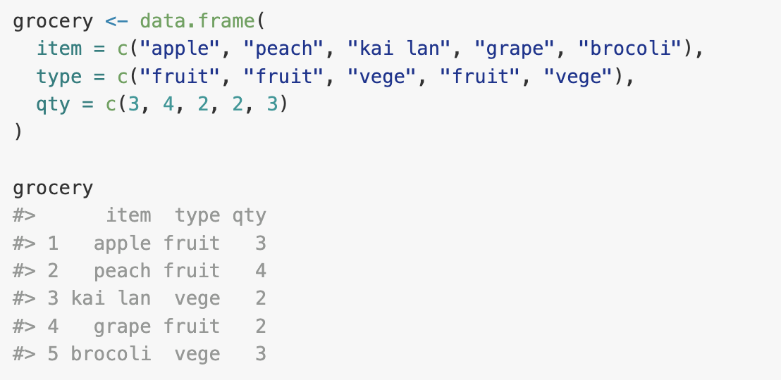

Slide 12
reprex package
Use to get pretty output
Ensure reproducibility
Shows input and output together
Can be copy and paste into R

Slide 13
The word ‘reprex’
Reproducible example
Name of a R package
A function within {reprex} package: reprex()

Slide 14
Other benefits of reprex
Solve the problem even before asking people
Improve my programming skill
Good for teaching
Prototyping

Slide 15
Where to ask questions?
Myanmar R User Group FB page
https://www.facebook.com/groups/878078163575014
Stackoverflow
https://stackoverflow.com/
Posit Community
https://community.rstudio.com/
Applied Epi Community Forum
https://community.appliedepi.org/
GitHub issues
https://github.com/

Slide 16
References
A talk by JD Long
https://youtu.be/0zNPgGa-Cu0
A talk by Jenny Bryan
https://youtu.be/5gqksthQ0cM
{reprex} website
https://reprex.tidyverse.org/
Reproducible example thread from Applied Epi Community
https://community.appliedepi.org/t/how-to-make-a-reproducible-r-code-example/167

